Slide 1
UNIT 1
INTRODUCTION TO JAVA PROGRAMMING AND ENVIRONMENT
By Mr. Mathews Chibuluma

Slide 2
Overview of Unit
Java technology is used to develop applications for a wide range of environments, from consumer devices to heterogeneous enterprise systems.
In this section, get a high-level view of the Java platform and its components, and various IDE for Java.

Slide 3
Objectives
Understand fundamentals of Java programming
Be aware of the important topics and principles of software development.
Have the ability to write a computer program to solve specified problems.
Be able to use the Java SDK environment using a specific IDE to create, debug and run simple Java programs.

Slide 4
Expected Learning Outcomes
Be able to understand better the object-oriented approach in programming. Students should be able to analyze and design a computer program to solve real world problems based on object-oriented principles.
Be able to use JDK and IDE to write computer programs to solve real world problems in Java
Be able to understand and explain what Java is about
To learn and appreciate the importance and merits of setting a local environment

Slide 5
Introduction
Java technology is used to develop applications for a wide range of environments, from consumer devices to heterogeneous enterprise systems.
In this section, get a high-level view of the Java platform and its components.
Like any programming language, the Java language has its own structure, syntax rules, and programming paradigm.
The Java language's programming paradigm is based on the concept of OOP, which the language's features support.

Slide 6
Java is
Object Oriented − In Java, everything is an Object. Java can be easily extended since it is based on the Object model.
Platform Independent − unlike many other programming languages including C and C++, when Java is compiled, it is not compiled into platform specific machine, rather into platform independent byte code. This byte code is distributed over the web and interpreted by the Virtual Machine (JVM) on whichever platform it is being run on.

Slide 7
Java Virtual Machine
Java Virtual Machine (JVM) is a engine that provides runtime environment to drive the Java Code or applications.
It converts Java bytecode into machines language.
JVM is a part of Java Run Environment (JRE).
In other programming languages, the compiler produces machine code for a particular system

Slide 8
Java is
Simple − Java is designed to be easy to learn. If you understand the basic concept of OOP, it would be easy to master.
Secure − With Java's secure feature it enables to develop virus-free, tamper-free systems. Authentication techniques are based on public-key encryption.
Architecture-neutral − Java compiler generates an architecture-neutral object file format, which makes the compiled code executable on many processors, with the presence of Java runtime system.

Slide 9
Java is…
Portable − Being architecture-neutral and having no implementation dependent aspects of the specification makes Java portable. Compiler in Java is written in ANSI C with a clean portability boundary, which is a Portable Operating System Interface (POSIX) subset.
Robust − Java makes an effort to eliminate error prone situations by emphasizing mainly on compile time error checking and runtime checking.
Multithreaded − With Java's multithreaded feature it is possible to write programs that can perform many tasks simultaneously. This design feature allows the developers to construct interactive applications that can run smoothly

Slide 10
Java is …
Interpreted − Java byte code is translated on the fly to native machine instructions and is not stored anywhere. The development process is more rapid and analytical since the linking is an incremental and light-weight process.
High Performance − With the use of Just-In-Time compilers, Java enables high performance.
Distributed − Java is designed for the distributed environment of the internet.
Dynamic − Java is considered to be more dynamic than C or C++ since it is designed to adapt to an evolving environment. Java programs can carry extensive amount of run-time information that can be used to verify and resolve accesses to objects on run-time.

Slide 11
Local Environment Setup
This section guides you on how to download and set up Java on your machine. The following are the steps to set up the environment.
Java SE is freely available from the link Download Java. You can download a version based on your operating system.
Follow the instructions to download Java and run the .exe to install Java on your machine.
Once you installed Java on your machine, you will need to set environment variables to point to correct installation directories

Slide 12
Popular Java Editors
To write your Java programs, you will need a text editor. There are even more sophisticated IDEs available in the market. But for now, you can consider one of the following −
Notepad − On Windows machine, you can use any simple text editor like Notepad (Recommended for this tutorial), TextPad.
Netbeans − A Java IDE that is open-source and free which can be downloaded from https://www.netbeans.org/index.html.
Eclipse − A Java IDE developed by the eclipse open-source community and can be downloaded from https://www.eclipse.org/.
IntelliJ IDEA Community Edition - the premier Java IDE in terms of both features and price, comes in two editions: the free Community edition, and the paid Ultimate edition, which has additional features.

Slide 13
Java Program
When we consider a Java program, it can be defined as a collection of objects that communicate via invoking each other's methods.
Let us now briefly look into what do class, object, methods, and instance variables mean.

Slide 14
Key Concepts
Object − Objects have states and behaviors. Example: A dog has states - color, name, breed as well as behavior such as wagging their tail, barking, eating. An object is an instance of a class.
Class − A class can be defined as a template/blueprint that describes the behavior/state that the object of its type supports.
Methods − A method is basically a behavior. A class can contain many methods. It is in methods where the logics are written, data is manipulated and all the actions are executed.
Instance Variables − each object has its unique set of instance variables. An object's state is created by the values assigned to these instance variables.

Slide 15
First Program
public class MyFirstJavaProgram{
/* This is my first java program.
* This will print 'Hello World' as the output
*/
public static void main(String[]args){
System.out.println("Hello World");// prints Hello World
}
}

Slide 16
Explanation
Let's look at how to save the file, compile, and run the program. Please follow the subsequent steps −

Slide 17
Writing a Java Program in Eclipse
To write a "Hello World" program follow these steps:
Start Eclipse.
Create a new Java Project: ...
Create a new Java class: ...
A Java editor for HelloWorld.java will open. ...
Save using ctrl-s. ...
Click the "Run" button in the toolbar (looks like a little man running).
You will be prompted to create a Launch configuration

Slide 18
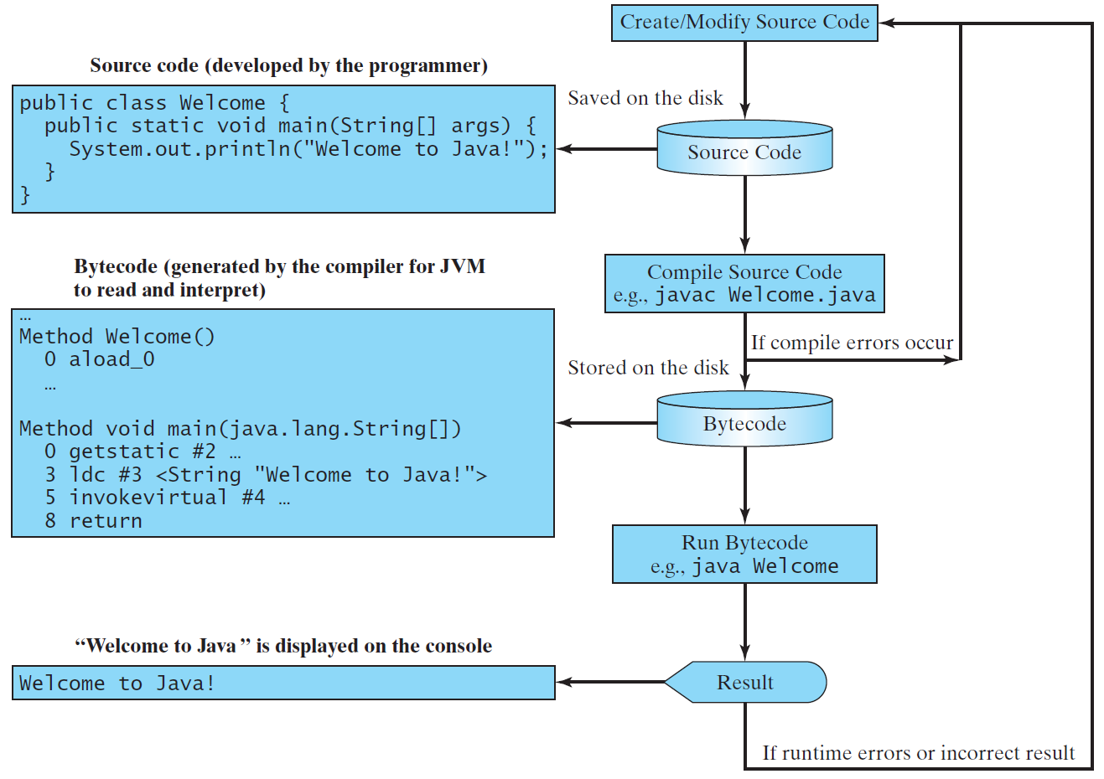
Creating, Compiling, and Running Programs

Slide 19
Compiling Java Source Code
You can port a source program to any machine with appropriate compilers.
The source program must be recompiled, however, because the object program can only run on a specific machine.
Nowadays computers are networked to work together. Java was designed to run object programs on any platform.
With Java, you write the program once, and compile the source program into a special type of object code, known as bytecode.
The bytecode can then run on any computer with a Java Virtual Machine, as shown below.
Java Virtual Machine is a software that interprets Java bytecode.

Slide 20
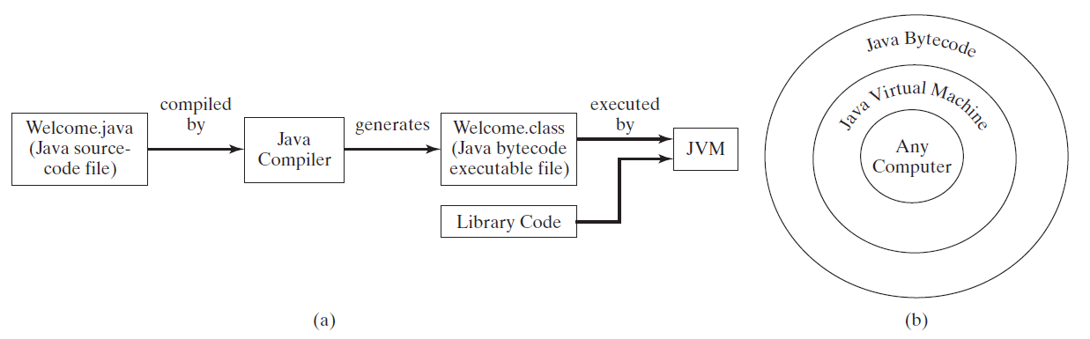
Compilation Process

Slide 21
Program
Enter main method
// This program prints Welcome to Java!
public class Welcome {
public static void main(String[] args) {
System.out.println("Welcome to Java!");
}
}

Slide 22
Execute statement
// This program prints Welcome to Java!
public class Welcome {
public static void main(String[] args) {
System.out.println("Welcome to Java!");
}
}

Slide 23
Anatomy of a Java Program
Class name
Main method
Statements
Statement terminator
Reserved words
Comments
Blocks

Slide 24
Class Name
Every Java program must have at least one class. Each class has a name. By convention, class names start with an uppercase letter. In this example, the class name is Welcome.
// This program prints Welcome to Java!
public class Welcome {
public static void main(String[] args) {
System.out.println("Welcome to Java!");
}
}

Slide 25
Main Method
Line 2 defines the main method. In order to run a class, the class must contain a method named main. The program is executed from the main method.
// This program prints Welcome to Java!
public class Welcome {
public static void main(String[] args) {
System.out.println("Welcome to Java!");
}
}

Slide 26
Statement
A statement represents an action or a sequence of actions.
The statement System.out.println("Welcome to Java!") in the program in Listing 1.1 is a statement to display the greeting "Welcome to Java!“.

Slide 27
Statement Terminator
Every statement in Java ends with a semicolon (;).
// This program prints Welcome to Java!
public class Welcome {
public static void main(String[] args) {
System.out.println("Welcome to Java!");
}
}

Slide 28
Reserved words
Reserved words or keywords are words that have a specific meaning to the compiler and cannot be used for other purposes in the program.
For example, when the compiler sees the word class, it understands that the word after class is the name for the class.
// This program prints Welcome to Java!
public class Welcome {
public static void main(String[] args) {
System.out.println("Welcome to Java!");
}
}

Slide 29
Blocks
A pair of braces in a program forms a block that groups components of a program.

Slide 30
Special Symbols

Slide 31
{ … }
// This program prints Welcome to Java!
public class Welcome {
public static void main(String[] args) {
System.out.println("Welcome to Java!");
}
}

Slide 32
( … )
// This program prints Welcome to Java!
public class Welcome {
public static void main(String[] args) {
System.out.println("Welcome to Java!");
}
}

Slide 33
;
// This program prints Welcome to Java!
public class Welcome {
public static void main(String[] args) {
System.out.println("Welcome to Java!");
}
}

Slide 34
// …
// This program prints Welcome to Java!
public class Welcome {
public static void main(String[] args) {
System.out.println("Welcome to Java!");
}
}

Slide 35
" … "
// This program prints Welcome to Java!
public class Welcome {
public static void main(String[] args) {
System.out.println("Welcome to Java!");
}
}

Slide 36
Programming Style and Documentation
Appropriate Comments
Naming Conventions
Proper Indentation and Spacing Lines
Block Styles

Slide 37
Appropriate Comments
Include a summary at the beginning of the program to explain what the program does, its key features, its supporting data structures, and any unique techniques it uses.
Include your name, class section, instructor, date, and a brief description at the beginning of the program.

Slide 38
Naming Conventions
Choose meaningful and descriptive names.
Class names:
Capitalize the first letter of each word in the name. For example, the class name ComputeExpression.
38

Slide 39
Proper Indentation and Spacing
Indentation
Indent two spaces.
Spacing
Use blank line to separate segments of the code.
39

Slide 40
Block Styles
Use end-of-line style for braces.
40

Slide 41
Programming Errors
Syntax Errors
Detected by the compiler
Runtime Errors
Causes the program to abort
Logic Errors
Produces incorrect result
41

